Slide 1
Adipocyte response to hypoxia-reoxygenation
Name:
Course:
Date:

Slide 2
Adipocytes
Found in adipose tissues subcutaneous fat and visceral fat.
White adipose tissue (WAT) and brown adipose tissue (BAT) .
WAT stores energy in the form of triglycerides
BAT functions to dissipate stored energy through heat production

Slide 3
Function of Adipocytes
mature adipocytes secrete cytokines- adipokines.
Adipokines autocrine and paracrine signalling.
Adipokines send signals to the liver and brain.
Adipocytes secrete leptin, adiponectin and resistin which are adipose-specific factors.
The study of adipocytes functioning helps study diabetes sand obesity.

Slide 4
Understanding adipocytes
Buoyancy of adipocytes limits there ability to be cultured.
differentiated adipocytes mature have multilocular lipid droplets.
mature adipocytes in WAT have a single large lipid droplet occupying the entire cytoplasm and pushing the nucleus peripherally.
Ischemia-reperfusion (I-R) causes pathogenesis of chronic skin wounds

Slide 5
Cont.
Restoration of I-R is essential in limiting tissue damage and eventual death.
Reperfusion can lead to additional tissue damage.
In I-R states, highly reactive oxygen species inflict damage on cellular structures.
e. In diabetic ulcers and pressure sores, direct pressure over a localized area causes I-R.

Slide 6
Methods
To isolate mature adipocytes Human subcutaneous fat tissues from elective abdominoplasties were used
Fat tissues were minced and were then treated with collagenase II (0.25%,prepared in HBSS.
The buoyant properties of adipose cells allowed for adipocytes separation from the mixture.

Slide 7
What was found out
The size of mature adipocytes show a positive correlation with body mass index.
Hydrogel-enclosed human mature adipocyte culture in vitro because
conventional culture methods do not work due to the buoyancy the mature cells.
Most cells were viable after isolation

Slide 8
Cont.
5-Bromo-20 -deoxy-uridine and Ki67 stained using BrdU staining kit.
Hematoxylin was used to visualize the hydrogel matrix.
For Ki67 detection, mouse anti-Ki67 was used as a primary antibody,
A signal was detected with the use of the Vectastain kit
Delivery of hydrogel/human adipocytes to Nu/Nu mice

Slide 9
Hydrogel-enclosed adipocytes after being cultured in vitro for 4 days showed viability.
Difficulty in the multiplicity of infection due to the floating of isolated human mature adipocytes medium.
Human adipocytes cultured in vitro contained proliferation markers.
Viability test and green fluorescence protein expression in mature adipocytes

Slide 10
Cont.
Reverse transcription quantitative polymerase chain reaction and Western blot analysis.
Pro-inflammatory genes upregulation in adipocytes in response to H-R.
Hydrogel-enclosed mouse mature adipocytes proliferate in vitro
Positive signals were found in adipocytes when fixed sections after anti-BrdU especific antibody.

Slide 11
Upregulated in adipocytes
Mouse mature adipocytes are functionally active cells that respond to hypoxia in vitro
Hypoxia treatment in human adipocytes compared with a normoxic control.
Increased VEGF protein expression was found in human adipocytes after hypoxia treatment.
mRNA expression of various cytoprotective, pro-inflammatory genes showed alteration.

Slide 12
Discussion
BMI and the size of mature adipocytes indicate a positive correlation.
It is important to analyze abdominal subcutaneous fat tissues obtained from elective abdominoplasties since anatomic location eventually affects the size of a mature adipocyte.
Adipocytes are buoyant in nature and this limits the culture of mature adipocytes in vitro.
Hydrogel develops an in vitro method to culture mature mouse adipocytes.
This hydrogel is made of hyraluronan and collagen.

Slide 13
Conti…
The hydrogel is used for:
Providing a 3-D matrix - the environment found in native adipose tissue
Keeping adipocytes from floating by forming a case around them
Adipocytes are metabolically active and function as endocrine cells by expressing and secreting many cytokine and hormones.
From the experiment, human adipocytes cultured in vitro responded to hypoxia and H-R.
I-R/H-R injuries bring about reactive oxygen species causing cell damage and an inflammatory cascade.

Slide 14
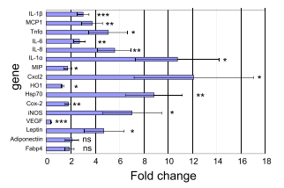
Conti…

Slide 15
Illustration
H-R resulted in the upregulation of multiple pro-inflammatory cytokines in adipocytes including:
MCP-1
MIP
IL-1a
IL-1b
IL-6
IL-8
Cxcl2
TNF-a

Slide 16
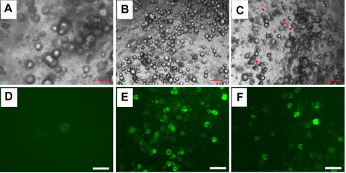
Looking into the possibility of performing gain-of-function studies in mature adipocytes, lentiviruses and adipocytes in hydrogel was enclosed and adipocytes were infected with GFP-expressing lentivirus and achieve GFP expression in adipocytes. See beside:

Slide 17
Conti…
Mature adipocytes were unable to get stocked in liquid Nitrogen.
This subdues the study compared to the use of primary pre-adipocytes.
A thought that crosses scientists is that mature adipocytes are differentiated cells that don’t proliferate.
BrdU labeling and Ki67 staining show that mature mouse and human adipocytes are able to proliferate in vitro.
Gene expression in visceral white adipocytes is different from that of subcutaneous adipocytes.

Slide 18
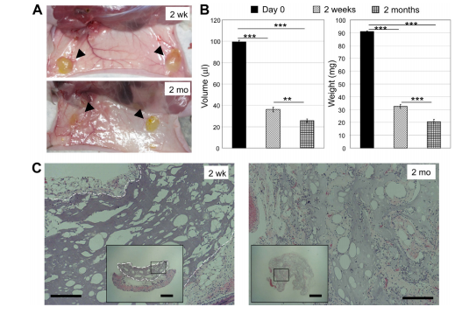
Summery of Adipocyte response to hypoxia-reoxygenation

